Slide 1
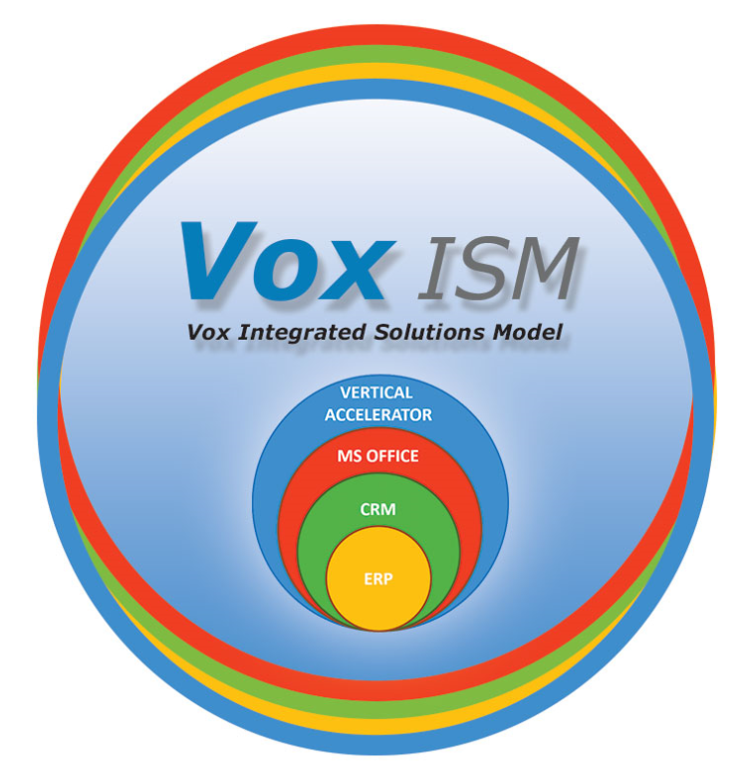
Jim’s Top 10 reports to get started
Sales Cube
Scorecard
CFO -Aged Accounts Receivable
Daily Flash Report
Income Statement for Jet Reports
NAV010 - Company Overview
NAV015 - Profit and Loss Variance
NAV016 - GL Monthly Income Statement
M
Let’s Get Started…

Slide 2
Income statements (3x)

Slide 5
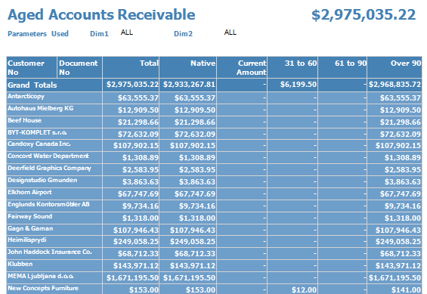
With drill down details, sent daily with subscription to branch managers

Slide 6
Emailed daily, automatically

Slide 7
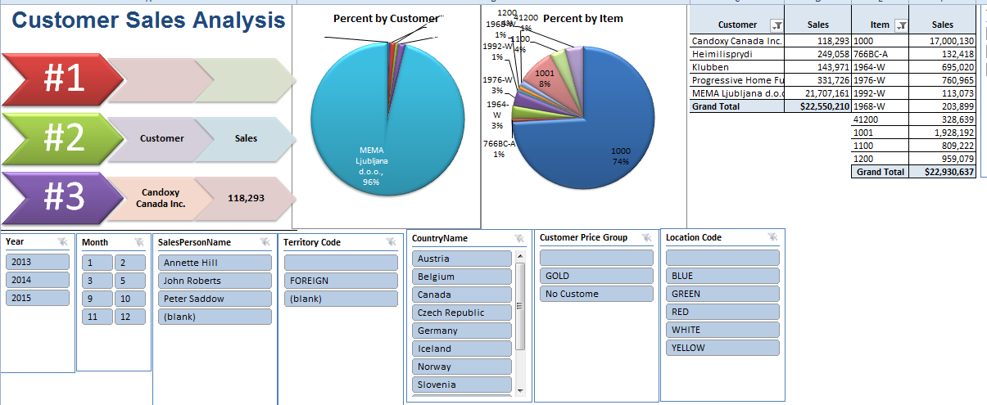

Slide 8
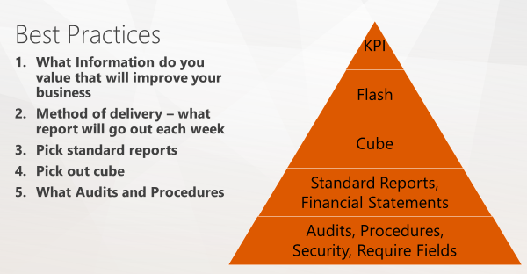
“Best Practice Recommendations” – what I did, Jim’s top 10 to get started, effort =
Reports | Method | Note/report name
Income | Jet Reports | 4 Options 80’s style Jet report GL Income Statement Profit and Loss Variance Company Overview
Balance Sheet | Jet Reports | e) In company Overview
Cash | NAV module
Aged Receivables | SSRS | SSRS + CRM AR Dashboard
Sales from CRM | CRM Dashboard | Jim’s Sales Dashboard
Operations | NAV Dashboard | Small Business Role Center
BI cube | Sales BI Cube
Flash report | SSRS Report

Slide 9
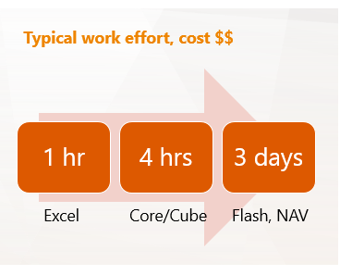
What Technology vs Effort $$$
Easy
Core Reports
Dashboards
Hard
Operational Reports and Audits
NAV custom reports
Excel BI cubes
KPI, ScoreCard
Flash Report
Typical work effort, cost $$

Slide 10
Management information systems (MIS), produce fixed, regularly scheduled reports based on data extracted and summarized from the firm’s underlying transaction processing systems^{[3]} to middle and operational level managers to identify and inform structured and semi-structured decision problems.
Decision support systems (DSS) are computer program applications used by middle and higher management to compile information from a wide range of sources to support problem solving and decision making. A DSS is used mostly for semi-structured and unstructured decision problems.
Executive information systems (EIS) is a reporting tool that provides quick access to summarized reports coming from all company levels and departments such as accounting, human resources and operations.
----------------------------------------------------------------------------------------------------------------------------------------------------------------------------------------------
Hierarchy of reporting – methods of delivery (reports, dashboards & KPI’s, BI Excel cubes) = 446 options – we need to pick a top 10 to get started!
Method | Count | System Type |  | Notes
NAV – core reports | 36 modules, 286 reports | MIS |  | Has report writer to tailor each report
NAV Dashboards | 32 role based | EIS
Jet Reports - essential | 36 | MIS
SQL reports |  | MIS & DSS
CRM – core reports | 3 modules, 25 reports | MIS
CRM dashboards | 3 core, unlimited | EIS
SQL reports - Vox ISM | 22 provided by VOX | MIS & DSS |  | Each report has variables
BI cubes | 4 cubes, each cube has 10 views | DSS
Flash reports | 1 | EIS |  | Use SQL subscription, automatic daily email
Audits | 1 | DSS |  | Great for inventory control

