Slide 1
Microsoft Dynamics NAV 2016 Finance Enhancements
Jared Hall
October 2015

Slide 2
What’s New
Finance is an important business domain. In Microsoft Dynamics NAV 2016, new and improved features enhance the user experience for accountants and bookkeepers.

Slide 3
Challenges to address
Missing role-specific finance functionality
Specific financial functionality is needed to improve the ease of use for Microsoft Dynamics NAV users.
Need to optimize reporting for North America
Existing options are not optimized for formatting and reporting in the North American localizations of Microsoft Dynamics NAV.
Limited support for complex Word form scenarios
There is a need to link custom Word forms to customers and specify e-mail addresses by document type. Users need one process to automatically generate the Word form associated with the customer.

Slide 4
What we need….
Posting Preview
Deferrals
Word Form and Email Enhancements
North America
Positive Pay
Report Enhancements
Document Totals

Slide 5
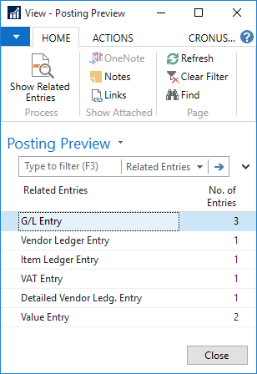
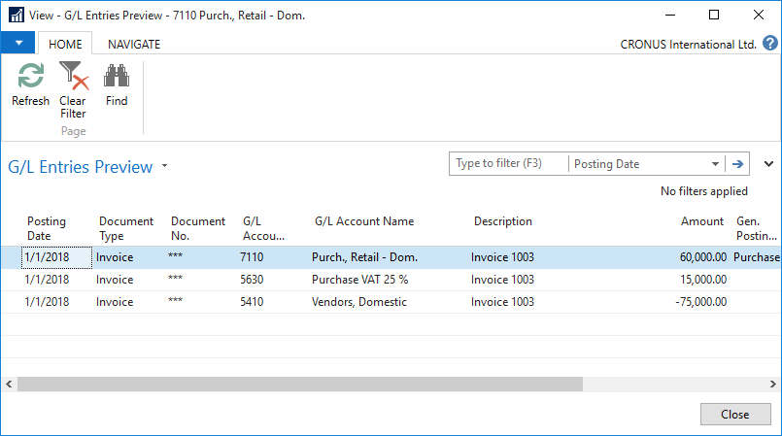
Posting Preview
Posting Preview functionality allows the user to, prior to posting, view the impact that posting the document will have against all affected ledgers.

Slide 6
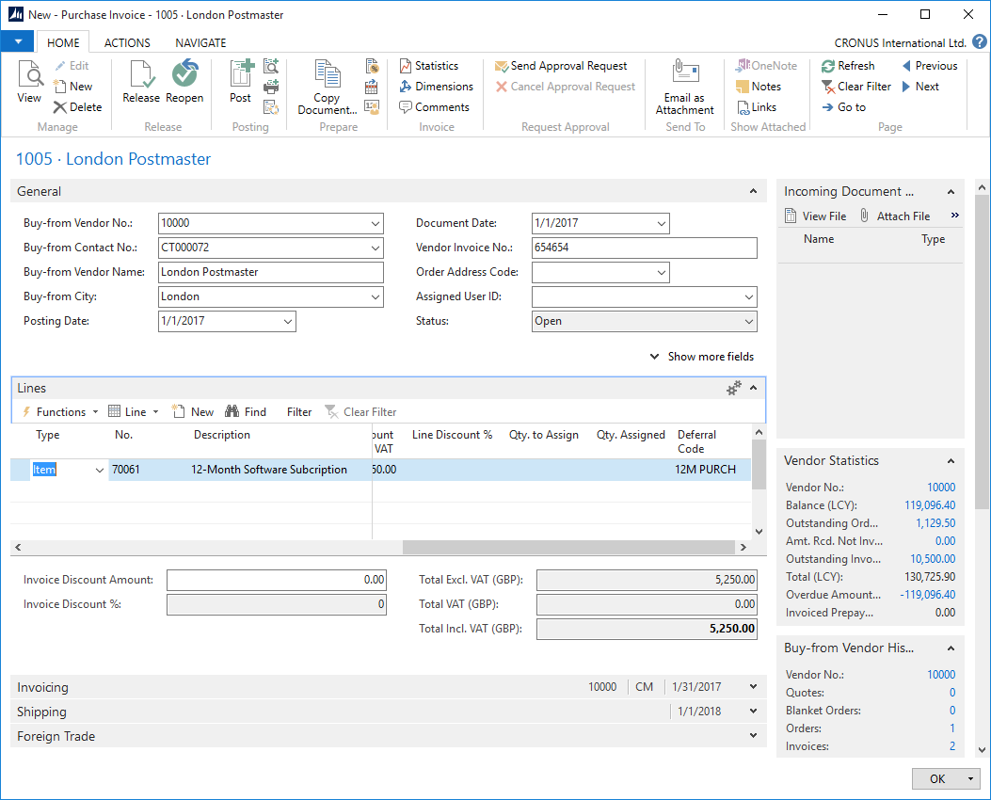
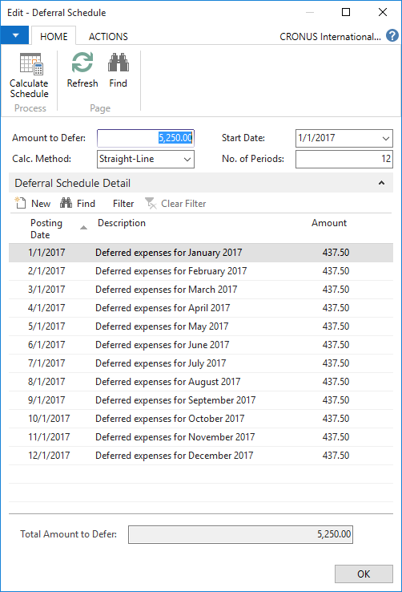
Deferrals
Deferral functionality allows the user to automate the process of deferring revenues and expenses over a pre-defined schedule.
This is available for:
Sales and Purchasing Documents
General Journals.

Slide 7
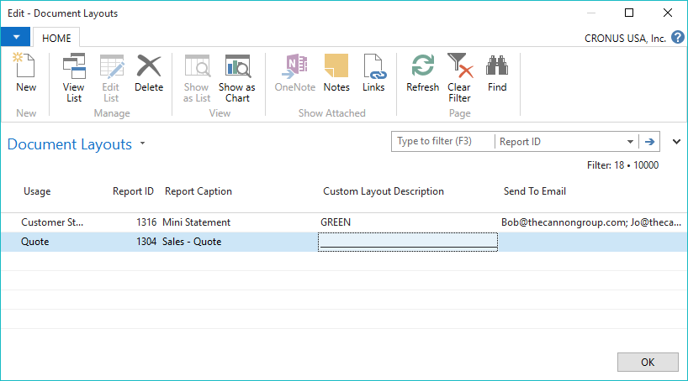
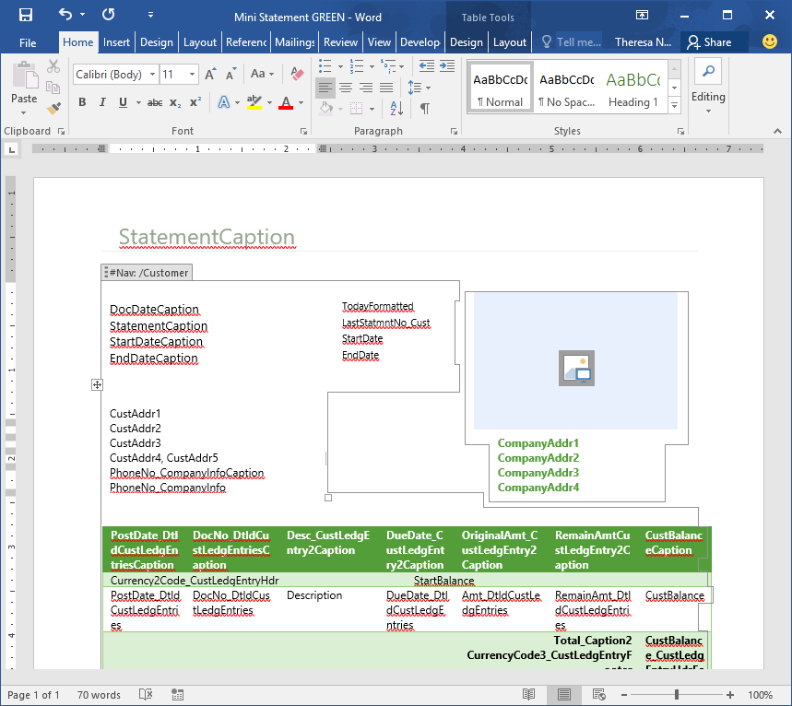
Word Forms and Email Enhancements
Word format defaults for customer statement and North America vendor remittance.
Assign Word format and email address by document type for each customer or vendor.
Processing customer statements or vendor remittances will use the assigned format and email to send the document.

Slide 8
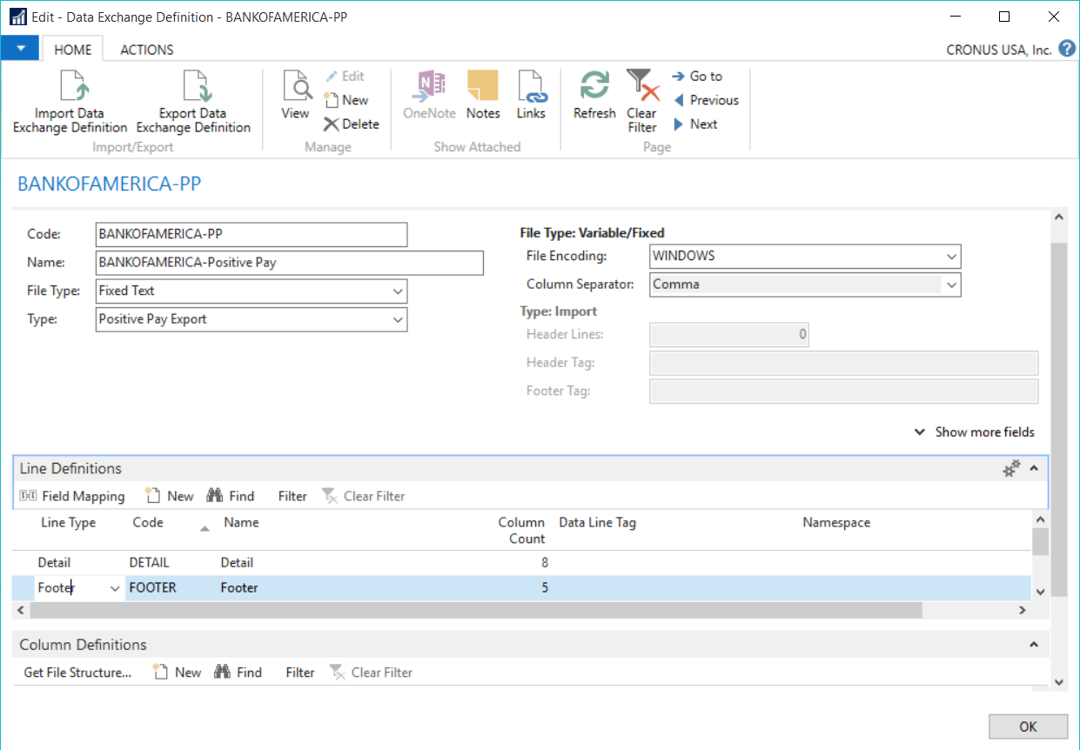
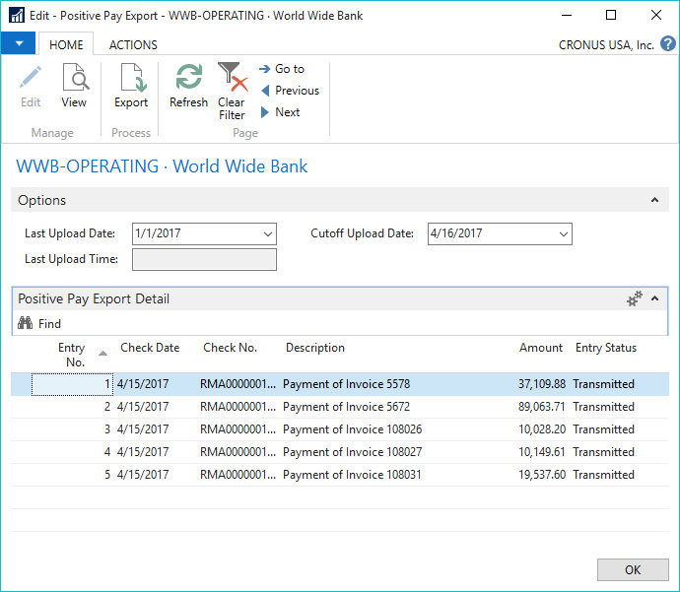
North America Positive Pay
Create a positive pay file with payment information to send to your bank.
Default formats available for Citibank and Bank of America.
Maintain positive pay history to view summary and detail for later reference

Slide 9
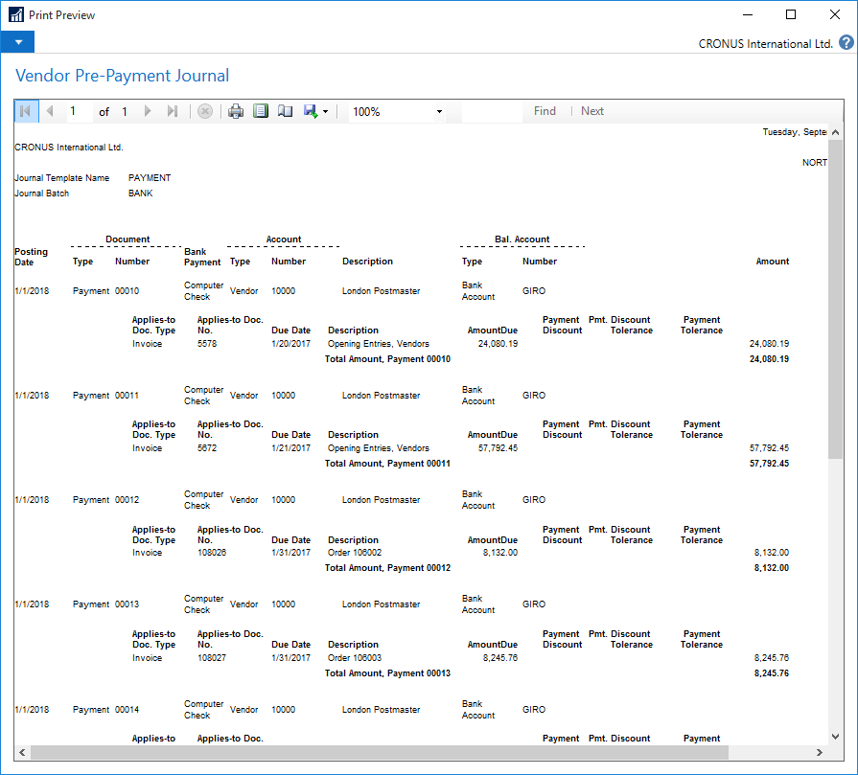
Report Enhancements
We updated existing reports, as well as created new reports.
The report updates for the North America localizations include updating the paper size to letter size.
Worldwide, we have changed 25 reports to landscape orientation.
We have also created the Vendor Pre-Payment Journal, available worldwide, which provides a preview of payment information for a payment journal.

Slide 10
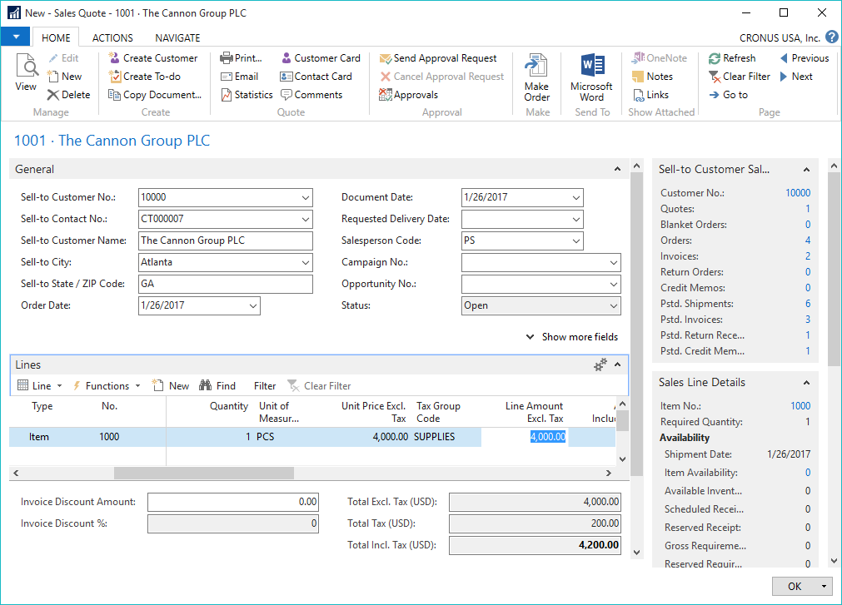
North America Document Totals
Display document totals in North America for
Invoice Discount
Total Excl. Tax
Total Tax
Total Incl. Tax
added for
sales order processing documents
purchase order processing documents

Slide 11
Learn more http://aka.ms/NavGetReady

