Slide 1
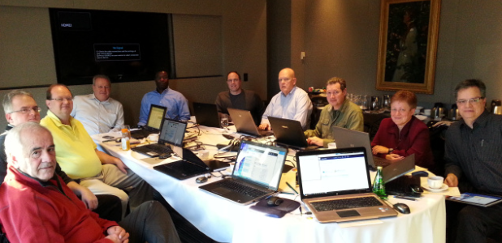
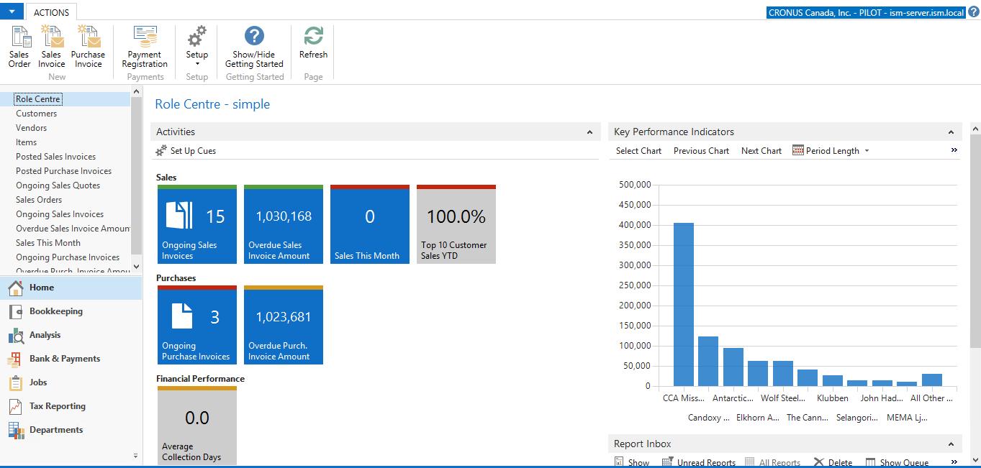
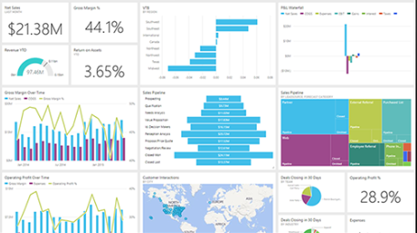
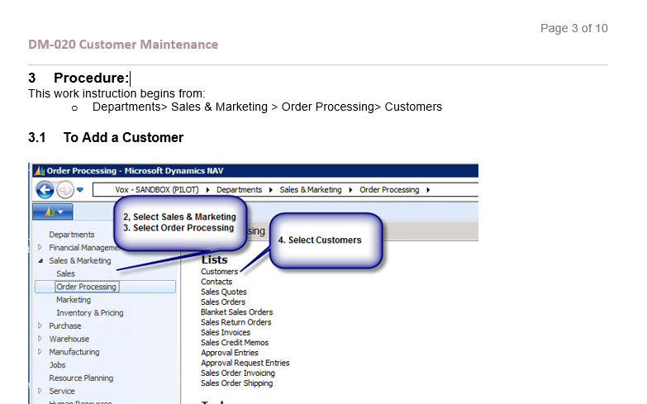
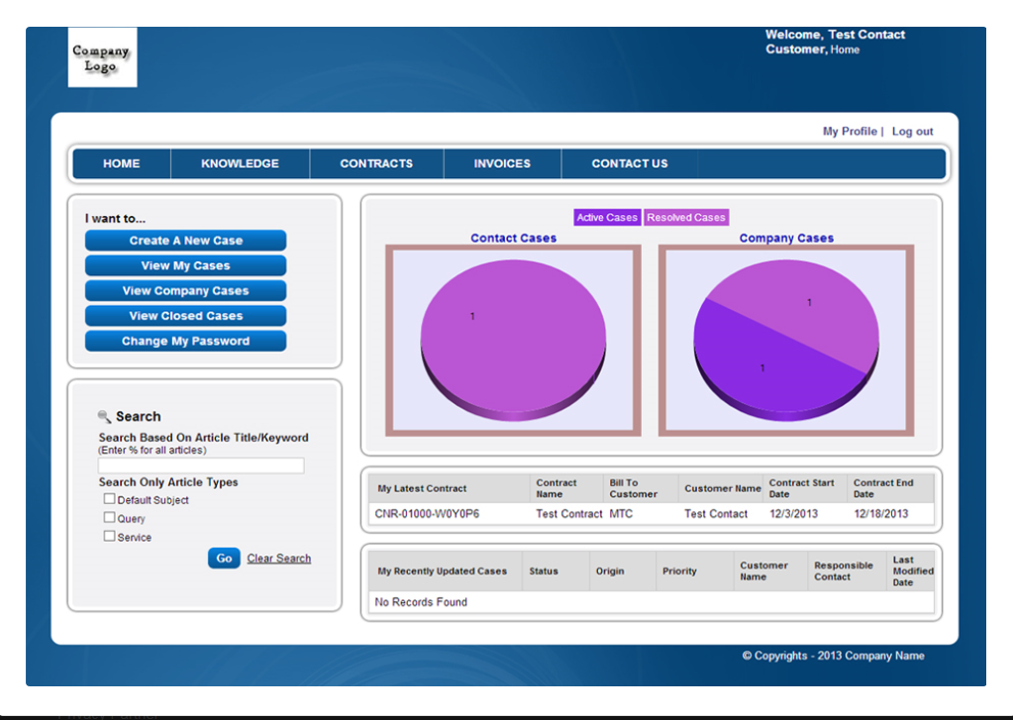
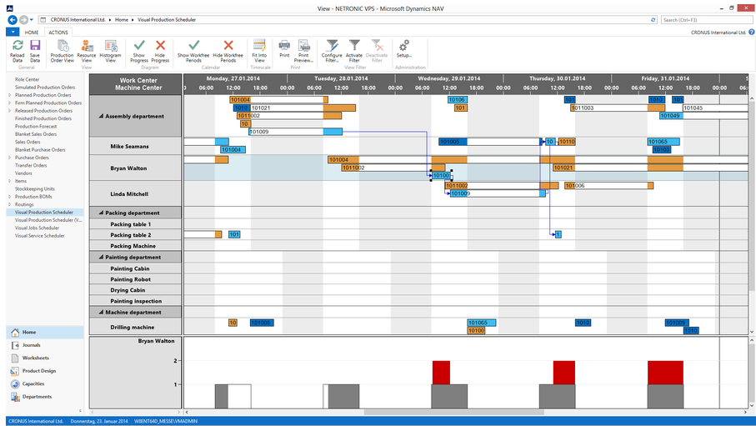
What is the Vox Vertical Accelerator?
Fall 2015
Why? Because we care
Microsoft Dynamics implementations can be less costly, lower risk and deliver a quicker ROI with Vox ISM Vertical Accelerator
A set of pre-configured business solutions based on the latest version of the Microsoft Dynamics that are designed to deliver core industry application processes, reduce implementation times, costs and risks, for customers in specific industries.
It saves you time and money
Starter Database
Business Intelligence
CRM
NAV
SOP’s and Videos
Customer Portals
Graphical Scheduler

Slide 2
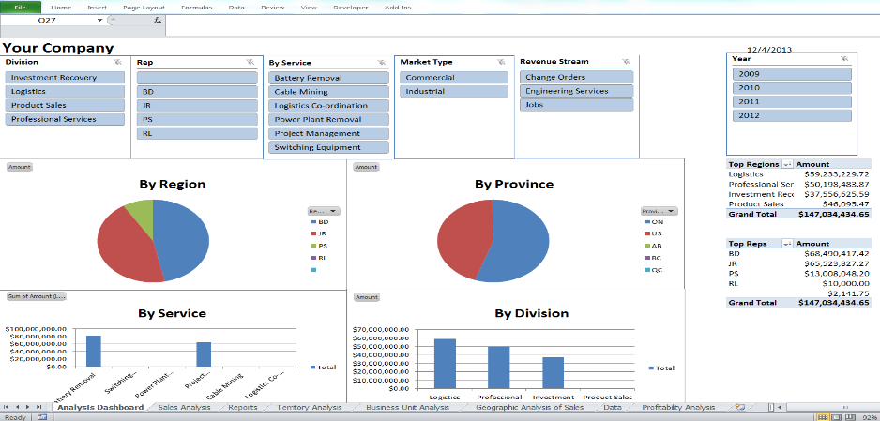
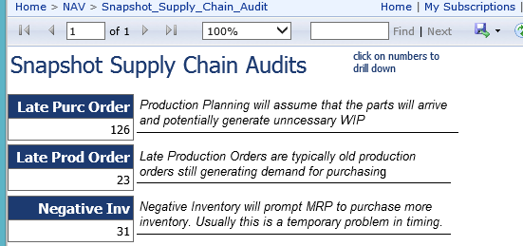
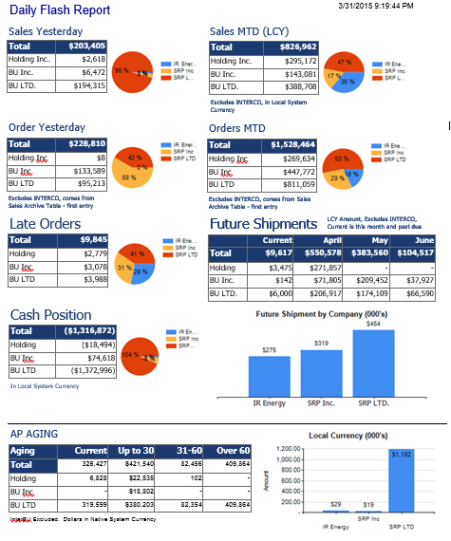
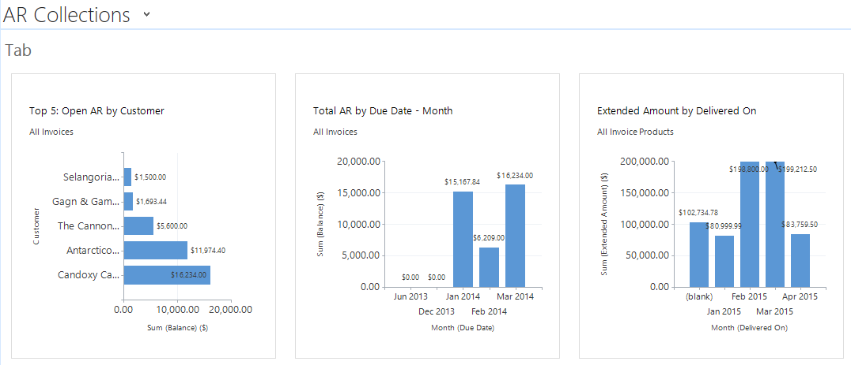
Business Intelligence
One of the biggest problems being face by managers today is that they struggle to get access to information they need to make informed and timely decisions
Running out the tools you have today (Outlook, Excel and SharePoint) each manager will have access to mobile and secure information
Vox has optimized the 4 main methods of management reporting for todays information requirements.
Business Analysis Cubes
Automatic Audits
Starter Database
Business Intelligence
SOP’s and Videos
Daily Flash Reports
Dashboards
Notes:
Made changes to BI and Dashboards, there are 3 things – BI, reports, and dashboards and audits. BI cube and dashboards. No value add, what did we do. Optimize BI reporting and Dashboards

Slide 3
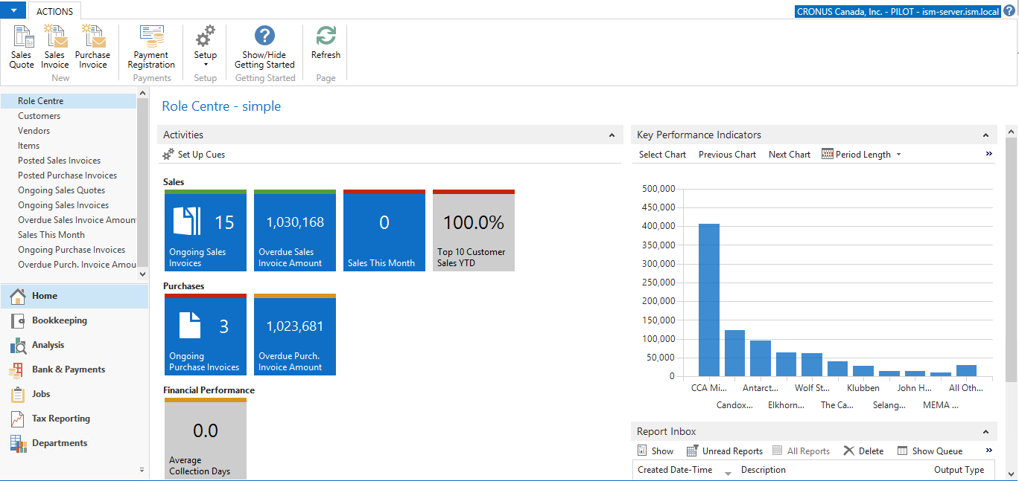
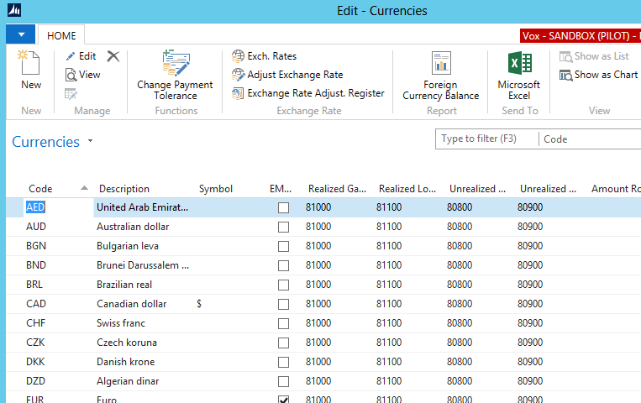
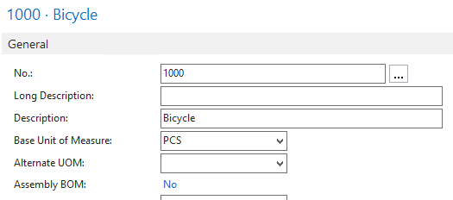
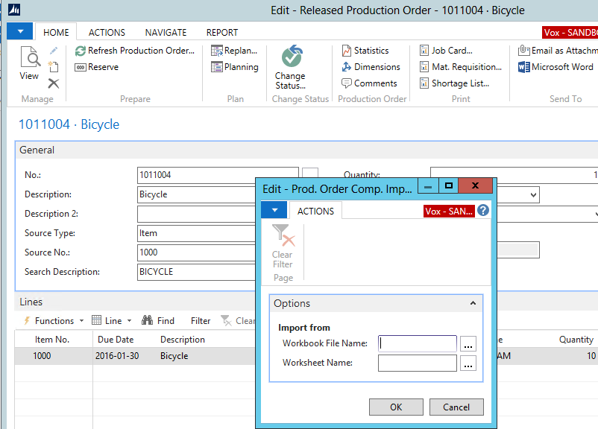
Starter Database
The Vox starter database is a series of improvements, configurations, needed enhancements and pre-entered data for Microsoft Dynamics NAV and Microsoft Dynamics CRM.
We’ve setup in advance things that everyone in Ontario needs (cheques and invoices, setup currencies and taxes, etc.)
Long descriptions, specifications, forms, reports and pages
You save time and money
Pre-Configured
Pre-Populated (Taxes, Currency, etc.
Starter Database
Business Intelligence
SOP’s and Videos
Long Descriptions and Specifications
Bill of Material Upload from CAD
Notes:
Made changes to BI and Dashboards, there are 3 things – BI, reports, and dashboards and audits. BI cube and dashboards. No value add, what did we do. Optimize BI reporting and Dashboards

Slide 4
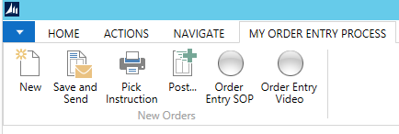
Education (Training Videos and Standard Operating Procedures)
Vox ISM provides your company with 63 standard operating procedures written in an ISO 9001 format
Vox ISM provides reference guides and recommendations to the best customer source courses provided by Microsoft
Vox ISM provides your company with quick links to the best YouTube videos on the internet
Notes:
Add the top part the SOP and Video from NAV.

Slide 5
Customer Service Portal
Inquiry
Enter Orders
Receivables
Customer Portal enables you to provide customers with highly personalized, interactive service on the Web. Your customers will be able to receive answers to their questions, complete transactions, submit support issues and query your knowledge base. With an open line of communication, and a range of self-service options, you'll boost customer satisfaction as well as long-term retention.
Check Order Status
Inventory Status

Slide 6
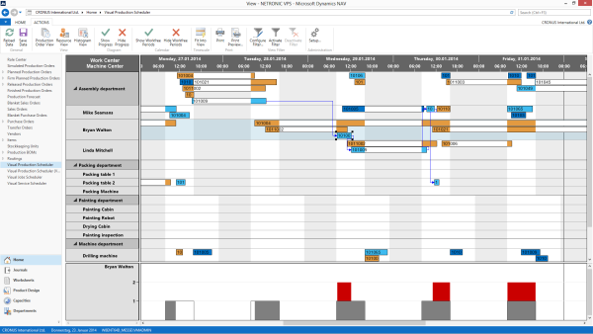
Graphical Scheduler
At one glance you can see production orders, due dates, resource workloads and bottlenecks.
The "drag-and-drop" feature allows you to make adjustments to the schedule quickly and simply by clicking and dragging with the mouse
You can zoom in and out to closely focus on a portion of the schedule or see the long –range plan of operations

Slide 7
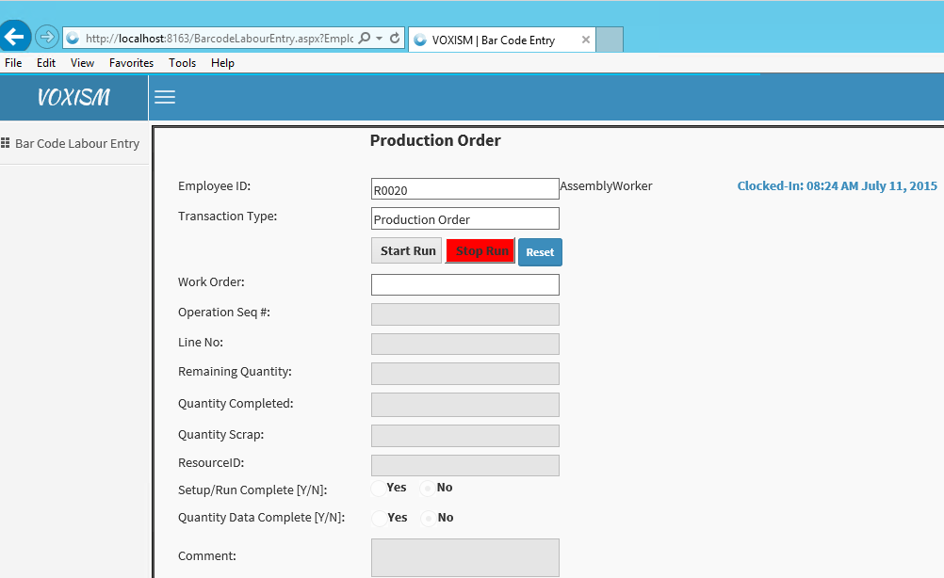
Barcoding
Labour barcoding provides real-time costing, tracking and scheduling on the shop floor.
It saves time, reduce errors, improves operational efficiency and provides traceability for manufacturers and distributors

Slide 8
Your business can do more and achieve more with the Vox Vertical Accelerator
More productive
Lower Cost
Faster
Notes:
All of this is enabled through the Microsoft Cloud for Business…

